Slide 1


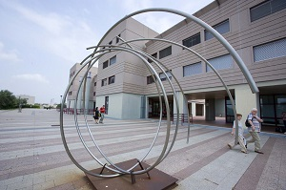
Faculty of Medicine and Surgery
Admission Test
Master Degree in
Medicine and Surgery
a.a. 2023/2024
October 17th 2023
a.a. 2023/2024 1 medschool.uniroma2.it www.uniroma2.it

Slide 2

Admission Test Medicine and Surgery a.a. 2023/2024
Canditates informations
Exam Date: October 17th 2023
Meeting Time for canditates registration: 8:30 a.m.
End of candidates registration (after this time no candidate can enter the exam’s hall): 11:30 a.m.
Start of the proof: 12:00 a.m.
Seat: Faculty of Medicine, Via Montpellier 1, 00133 Rome, Italy
Candidates location: https://web.uniroma2.it/it/percorso/offerta_formativa/sezione/medicine_and_surgery
End of the Proof: 01:40 p.m.
All candidates MUST RESPECT THE ABOVE-MENTIONED TIMES FOLLOWING THE MARKED ROUTES
Please note that, except for candidates with disabilities, ESCORTS CANNOT ENTER the admission test area. Access will be allowed to candidates ONLY.
a.a. 2023/2024 2 medschool.uniroma2.it www.uniroma2.it

Slide 3
Admission Test Medicine and Surgery a.a. 2023/2024
Required Documentation
EACH CANDIDATE MUST PROVIDE THE FOLLOWING DOCUMENTS
A valid identification document (no copies or reproduction will be accepted);
A receipt demonstrating the online registration on Universitaly website;
A receipt of payment showing that the date of payment has been done before September 29nd.
Non EU applicants living in Italy must show:
Permission of Stay
Non EU applicants living in foreign countries must be provide with:
VALID Passport
A copy of the pre-registration application submitted to Universitaly website.
a.a. 2023/2024 3 medschool.uniroma2.it www.uniroma2.it

Slide 4
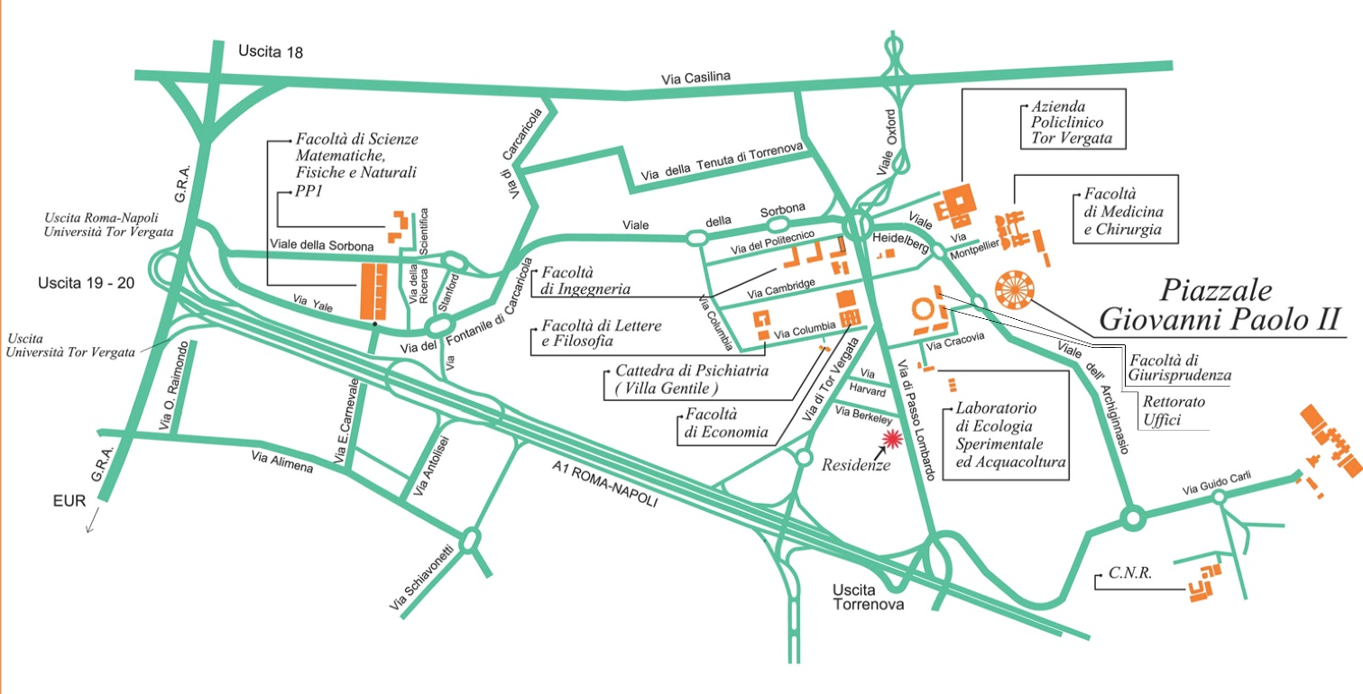
Admission Test Medicine and Surgery a.a. 2023/2024
How to arrive to the Campus
By car
From Napoli: Autostrada A1 Roma - Napoli, exit 19-20 Torrenova - via di Passo Lombardo (follow road signs to Università di Tor Vergata, Faculty of Medicine)
From Grande Raccordo Anulare (G.R.A.): exit 19-20 Torrenova follow road signs to Romanina-2nd University, follow via Vittorio Ragusa, turn left to via Mario Pastore then turn right on via Stanford (follow road signs to Facoltà di Medicina- Università Tor Vergata)
From Roma or Castelli Romani: via Tuscolana, via di Tor Vergata to Università di Tor Vergata.
Public transportations (main)
Underground Linea A to Anagnina, till the end of the line (Anagnina); take a bus to the final destination:
linea 20 express to the Faculty of Medicne and Surgery. Direction: via Cambellotti (Tor Bella Monaca);
linea 500 to the Faculty of Medicine and Surgery.
Underground Linea C to Pantano: get off at the Torre Angela station; take a bus to the final destination:
linea 20 express to Faculty of Medicine and Surgery. Direction: Anagnina (Metro A)
linea 500 to the Faculty of Medicine and Surgery. Direction: Anagnina (Metro A).
a.a. 2023/2024 4 medschool.uniroma2.it www.uniroma2.it

