Slide 1
Lump Sum Funding in Horizon Europe: How does it work? How to write a proposal?
European Commission, DG rtD
Common Implementation Centre
11 February 2026

Slide 2
Why do we use lump sum funding?
  Reducing the financial error rate
  Following the ECA annual reports 2019 and 2020, there is wide agreement that the error rate in the R&I Framework Programmes must be reduced
  Lump sums are a key measure to achieve this in Horizon Europe
  Significant simplification potential
  Funding based on reimbursement of real costs remains complex and error-prone. Little scope for further simplification
  Lump sums remove the obligation to report actual costs and resources
  Easier to use for beneficiaries with limited experience
  Focus on content
  Focus less on financial management and more on content

Slide 3
Why do we use lump sum funding?
  Easier access to the programme
  Very small share of beneficiaries have more than 100 grants:
    Large entities
    Dedicated staff and procedures to deal with actual costs
  Vast majority of beneficiaries have only 1 or 2 grants per programme
    Most of them SMEs or newcomers
    Little or no previous experience
    Need a simple funding model

Slide 4
Common understanding needed
We need to explain lump sums, but we see no blocking issues
We are aware of concerns
  More work to set up a proposal
  Less flexibility in grant management
  Higher financial risk, leading to fewer newcomers, fewer SMEs, less ambitious proposals
We are aware of misunderstandings
  Budget details are only needed for lump sums (not true)
  Lump sum payments depend on a successful outcome (not true); partially completed lump sum work packages will not be paid (not true)
  In actual cost grants, beneficiaries have fewer obligations; reimbursement only requires correct invoices and is independent of other partners (all not true)

Slide 5
Two lump sum options
Type 1
Lump sum fixed in the call for proposal
Type 2
You define the lump sum in your proposal
So far, except ERC Proof of Concept and EIC Advanced Innovation Challenges Phase 1, all lump sum topics under Horizon Europe are Type 2.

Slide 6
Writing a lump sum proposal
  To write a lump sum proposal, you:
    Use the standard Horizon Europe application form
    Present the objectives and methodology of your project and address the expected outcomes and impacts as in any Horizon Europe proposal
    Describe in detail the activities covered by each work package.
  To define and justify the lump sum, you need to provide a detailed budget table with cost estimations. This is:
    An Excel file that you download from the online submission system, fill it and submit it as an annex to the Part B application form.
    OR
    Implemented directly in Part A online forms in the submission system (no Excel).

Slide 7
Novelties in WP 2026-2027
  Detailed lump sum budget in Part A online forms:
    Currently used in 9 topics in Cluster 5
    Full roll-out expected in the course of 2026
    Same level of budget information is required (see online instructions)
    Lump sum topics use the Excel file OR the Part A budget (never both)
  Simplified proposal template
    Table 3.1h ‘Purchase costs’ was simplified, and tables 3.1i ‘Other costs categories’ and 3.1j ‘In-kind contributions’ were removed
    The justifications previously included in these tables must now be included in the comments tab (Excel) or comments box (Part A)
    This addresses a frequent request to have cost estimates and justifications in a single place
    Instructions will be updated as soon as possible

Slide 8
Writing a lump sum proposal
  In this detailed budget table, you provide cost estimations for each cost category per beneficiary (and affiliated entity if any) and per work package.
  The cost estimations must be an approximation of your actual costs. They:
    are subject to the same eligibility rules as in actual costs grants
    must be in line with your normal practices
    must be reasonable / non-excessive
    must be in line with and necessary for your proposed activities.
  The cost estimations are used to generate in the detailed budget table a breakdown of lump sum shares per work package and per participant.
  Details and instructions on how to fill in the lump sum detailed budget table are provided in the Funding & Tenders portal and in the online form itself.

Slide 9

Project design – Work packages
  Work package distribution
  A work package (WP) is a major sub-division of the work plan of your project.
    Work packages with a long duration may be split along the reporting periods (e.g., Management, Dissemination and Exploitation, etc.). In this way, the relevant activities can be paid at the end of the reporting period.
As many as needed but no more than what is manageable
    A single activity is not a WP
    A single task is not a WP
    A % of progress is not a WP (e.g. 50 % of the tests)
    A lapse of time is generally not a WP (e.g. activities of year 1)

Slide 10
Splitting work packages - example
Single long-duration work package
Split work packages, same content
Splitting WPs along the boundaries of reporting periods allows activities to be reimbursed at intermediate payments.
In case the resulting work packages have the same tasks, there is no need to repeat the same description for each split work package in the proposal (part B, table 3.1b).
Splitting *
Splitting WPs is entirely optional. It should be used if needed to optimise the cash flow.

Slide 11
Evaluation of a lump sum proposal
  Your proposal will be evaluated by independent experts against the standard evaluation criteria: excellence, impact, and implementation.
  The cost estimations will be assessed against the proposed activities under the implementation criterion.
  Experts will:
    ensure that the cost estimations are reasonable and non-excessive
    evaluate whether the proposed resources and the split of the lump sum allow completing the activities described in the proposal.
  If the experts find overestimated costs, they make concrete recommendations on the budget that are recorded in the Evaluation Summary Report. This will be reflected in a modified lump sum amount in the grant agreement.
  If the lump sum budget needs to be modified, this does not decrease your proposal’s chances of success. However, serious flaws in the proposed budget reduce the score.

Slide 12
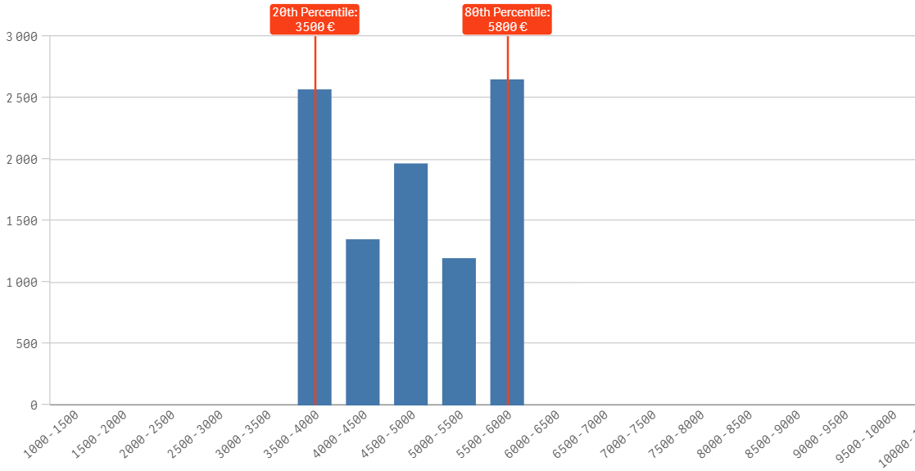
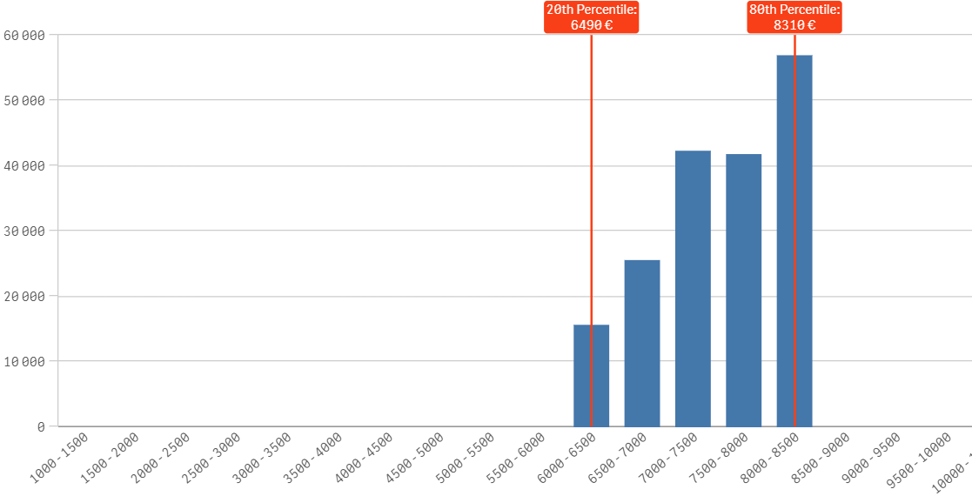

Horizon dashboard for lump sum evaluations
  Evaluation experts must use the dashboard as an orientation to ensure that budgets are reasonable and non-excessive.
  For each combination of country and organisation type selected, the dashboard displays the distribution between the 20th and the 80th percentile, and the median personnel costs.
  Based on grants signed from 2022 (data last refreshed: 19 Nov 2025).
  Applicants justify high personnel costs in the ‘comments’ section of the detailed budget table.
Personnel costs for Research Organisations in Romania
Total person-months
Personnel costs for Research Organisations in Germany
Access the dashboard here
ERC Advanced Grants use a different dashboard for lump sum evaluations.
Average personnel costs (per month per person)

Slide 13
Grant preparation
  We follow the standard process to prepare the grant agreement.
  The grant agreement for your project will be based on the Model Grant Agreement for lump sum grants.
  The ‘no negotiation’ principle applies. The grant agreements is prepared on the basis of the proposal you submitted. However, some changes might be necessary:
    correcting obvious errors and inconsistencies
    other changes necessary to comply with applicable rules
    adjustment of the lump sum to the amount specified in the Evaluation Result Letter
  The breakdown of lump sum shares per beneficiary and per work package is included in the grant agreement as Annex 2. The submitted detailed lump sum budget table is not part of the lump sum grant agreement.
  Once the lump sum is fixed in the grant agreement, it will not be questioned if the prices for goods or services change later on.

Slide 14
Budget allocation
  Budget allocation (annex 2 to the grant agreement)
 | WP1 | WP2 | WP3 | WP4 | WP5 | WP6 | WP7 | WP8 | Total
Beneficiary A | 250.000 |  |  | 50.000 | 300.000 | 250.000 |  | 300.000 | 1.150.000
Beneficiary B |  | 250.000 | 350.000 | 50.000 |  |  | 100.000 | 150.000 | 900.000
Beneficiary C | 100.000 | 100.000 |  | 50.000 |  | 280.000 |  |  | 530.000
Beneficiary D |  | 120.000 |  | 50.000 |  |  | 100.000 | 150.000 | 420.000
Total | 350.000 | 470.000 | 350.000 | 200.000 | 300.000 | 530.000 | 200.000 | 600.000 | 3.000.000
Shares of the lump sum per beneficiary
Lump sum
=
Maximum grant amount
Shares of the lump sum per WP
  You can use the budget as you see fit as long as the project is implemented as agreed. The actual distribution of the lump sum is invisible to us.
  Budget transfers between work packages and/or partners require an amendment if the consortium wants to reflect them in the grant agreement.

Slide 15
Amendments
Possible amendment types
(examples)
Changes in the work plan
Changes of the lump sum shares
Adding or removing participants
Additional activities to be subcontracted
Transfer of tasks between beneficiaries
Change of the project duration / reporting periods
Lump sum grants can be amended.
Same procedure and conditions as for all Horizon grants.
Lump sum work packages that have already been paid cannot be amended.
A technical review is needed to amend Horizon 2020 lump sum grants (no longer needed under Horizon Europe).
Deviations from the work plan can also be flagged in the periodic report (simplified procedure).

Slide 16

Payment schedule
  Types of payments:
  Same function and same rules as for other grants
  Coordinator distributes the amount according to consortium agreement
  One or more
  We pay the shares of the lump sum set out in Annex 2 for the work packages completed & approved in the reporting period
  Closes the financial aspects of the grant
  Partial payment for partially completed WPs possible
  Releases the amount retained for the Mutual Insurance Mechanism
Pre-financing payment
Interim payment(s)
Payment of the balance

Slide 17
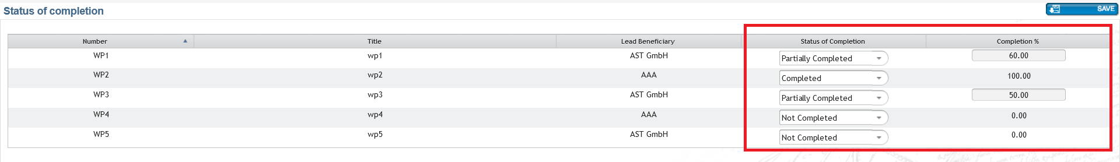
Reporting and payment (1)
Use the standard reporting template
The coordinator declares work packages as Completed or Not Completed. This should be justified by the technical periodic report.
An incomplete work package can be completed and paid in a subsequent reporting period.
At the final reporting period, it is possible to declare Partially Completed work packages, and to enter the percentage of completion.
The completion of work packages is not based on a successful outcome, but on the completion of activities as described in the description of action.

Slide 18
Reporting and payment (2)
The financial report is much simplified and to a large extent automated.
The financial statement for all beneficiaries is automatically generated (based on the accepted work packages and the corresponding lump sum shares).
 | WP1 | WP2 | WP3 | WP4 | WP5
Beneficiary A | 250.000 |  |  | 50.000 | 300.000
Beneficiary B |  | 250.000 | 350.000 | 50.000
Beneficiary C | 100.000 | 100.000 |  | 50.000
Beneficiary D |  | 120.000 |  | 50.000
Total | 350.000 | 470.000 | 350.000 | 200.000 | 300.000
Interim payments pay the lump sum shares for completed work packages.
Final payments can also pay partially completed work packages.
✓
✗
✓
✗
Payment = 350 000 + 0 + 350 000 + 0 = 700 000 €

Slide 19
Acceptance of work packages
  Work packages are accepted if the activities have been carried out. We can also accept them when all essential tasks have been completed, when equivalent tasks have been carried out, or when deviations have been justified.
  Lump sum projects can be amended according to scientific-technical needs (or deviations can be justified in the reports). Use these mechanisms to make completion of work packages feasible.
  Before a lump sum work package (that you declared completed) is rejected as incomplete, you are invited to respond to the observations of the project officer.
  If the rejection is upheld the lump sum share concerned is not paid at that point in time. You should complete the work package later and declare it at the end of any subsequent reporting period.
  If it is not possible to complete a work package by the end of the project (e.g., for technical reasons or due to force majeure), the lump sum is paid partially in line with the degree of completion. The decision on the partial amount is taken on a case-by-case basis. You will be able to provide observations.

Slide 20
Acceptance of work packages – in practice
  1 060 closed lump sum grants (Jan 2026)
  At final payment
  99% were paid as declared
  1% were partially rejected
  At intermediate payment
  Rejection of work packages is rare (2%); → payment delayed to the next reporting period
  Controls work
  No evidence of increased financial risks for beneficiaries
of which

Slide 21

Ex-post controls
Checks, reviews and audits for:
Proper implementation of the action (e.g. technical review)
Compliance with the other non-financial obligations of the grant, e.g.
  IPR obligations
  Ethics and integrity
  Open science
  Dissemination
  Etc.
No financial checks, reviews and audits by EU services

Slide 22
Keeping records
Consortium needs to keep (e.g.)
Technical documents
Publications, prototypes, deliverables
…any document proving that the work was done as detailed in Annex 1
Consortium doesn't need to keep*
Time-sheets
Pay-slips or contracts
Depreciation policy
Invoices
…any documents proving the actual costs incurred
Documentation required by good research practices such as lab books
*You still need to comply with financial record keeping obligations outside the grant agreement, if any (e.g., under national law or internal procedures)
Same as for all Horizon Europe grants

Slide 23

Resources available
One dedicated lump sum page on the Funding &Tenders Portal with:
Video tutorials
Overview of lump sum funding
Guidance documents
What do I need to know? & Quick guide
Reference documents
Model Grant Agreement Lump Sum
Studies
European Commission assessment (Oct 2021)
Events
Future events
Past events and recordings
European Parliament (STOA) study on lump sums in Horizon 2020 (May 2022)
Decision authorising the use of lump sum contributions under the Horizon Europe Programme
Frequently asked questions
Detailed guidance for participants
Lump sum briefing slides for experts
Horizon dashboard for lump sum evaluations
Detailed budget table
European Commission assessment (Sep 2024)

Slide 24
Research Enquiry Service
For questions about research and Horizon Europe, you can contact the Research Enquiry Service via the webform:
Research Enquiry Service (europa.eu)

Slide 25
Current developments
  Continuous monitoring of lump sum grants, adjustments if necessary
  Assessment of lump sum funding in H2020 and HE (completed in July 2024)
  Ex-post technical reviews for lump sum grants, variant of existing project reviews
  Roll-out of the detailed lump sum budget in Part A application forms
  Stepwise roll-out of lump sums:
  2021-2022: 2%
  2023: > 10%
  2024: 27%
  2025: 35%
  2026-2027: 50%

Slide 26
Thank you!
# HorizonEU
http://ec.europa.eu/horizon-europe

